Slide 1
Q-Yield
Roadshow Presentation

Slide 2
Agenda
Revenue Management Role
Revenue Management Approaches
Revenue Gains with RM System
Basic Elements of RM
Passenger Behavior
Forecasting / Optimization

Slide 3
Revenue Management Role
Each aircraft seat is a perishable commodity
  Once a flight leaves the ground, the opportunity to sell a seat on the plane is gone
  Every empty seat is a lost revenue opportunity that we can never recapture
  Lost revenue opportunities must be minimized

Slide 4
Revenue Management Role
Revenue management means not selling a seat today at a low fare if it can be sold tomorrow at a higher fare
BUT ALSO ...
Revenue management means allowing the seat to be sold today at a low fare if it is otherwise likely to remain unsold

Slide 5
Revenue Management Role
Maximizes profitability by managing the relationships among price, demand and capacity
Requires a willingness to say “no” to unprofitable business opportunities

Slide 6
Revenue Management Role
To accurately predict future demand (for each fare product and point-of-sale)
To maximize revenue on every flight by setting inventory allocations reflecting the forecast of passenger demand and their willingness to pay
To minimize seat spoilage and risk of denied boardings

Slide 7
Revenue Management Role
Most airlines evaluate their performance based on a number of variables
  ASK: available seat kilometers; measurement of capacity
  (ASK = Revenue / Capacity / Distance)
  RPK: revenue passenger kilometers; measurement of traffic
  (RPK = Revenue / Seats Sold / Distance)
  Load Factor: percentage of airline’s capacity being used
  Yield: what each passenger is paying per kilometer
  RASK: average revenue an airline is receiving per seat km.

Slide 8
Agenda
Revenue Management Role
Revenue Management Approaches
Revenue Gains with RM System
Basic Elements of RM
Passenger Behavior
Forecasting / Optimization

Slide 9
RM Approaches
To manage the function of inventory control, airlines have adopted a philosophy based on one of three approaches:
  Load Factor
  Yield
  Revenue

Slide 10
The Load Factor Approach
The primary emphasis is to sell as many seats as possible
Hence, there are few or no limits placed on the availability of seats in any class
The number of lower-fare class seats sold will generally be higher with this approach
The concept here is that the more seats sold the better (with little consideration for revenue)

Slide 11
Inventory Control Example
Assume a flight leg of 2,100 kilometers; capacity = 200 seats
Load Factor Emphasis
0
13
14
55
68
150
75%
€ 25,960
€ 173
8.24
6.18
Class
Y
M
Q
B
V
Seats Sold
Load Factor
Total Revenue
Average Fare
Revenue per RPK
Revenue per ASK
Average Fare
€ 420
€ 360
€ 230
€ 180
€ 120
in cents
in cents
[RPK = Revenue / Seats Sold / KM] [ASK = Revenue / Capacity / KM]

Slide 12
The Yield Approach
The primary emphasis is to sell seats at high fares
This is generally accomplished by limiting the number of lower fare seats available for sale
The average fare of the seats sold under this approach will be higher than the other two approaches
The Yield Approach will result in lower load factors as the quantity of seats sold is not as important as the high value at which they are sold

Slide 13
Inventory Control Example
Assume a flight leg of 2,100 kilometers; capacity = 200 seats
Load Factor Emphasis
0
13
14
55
68
150
75%
€ 25,960
€ 173
8.24
6.18
Class
Y
M
Q
B
V
Seats Sold
Load Factor
Total Revenue
Average Fare
Revenue per RPK
Revenue per ASK
Average Fare
€ 420
€ 360
€ 230
€ 180
€ 120
Yield Emphasis
20
23
22
30
15
110
55%
€ 28,940
€ 263
12.53
6.89
in cents
in cents
[RPK = Revenue / Seats Sold / KM] [ASK = Revenue / Capacity / KM]

Slide 14
The Revenue Approach
Under the Revenue Approach, an effort is made to maximize revenue by selling the right number of seats at different fare levels according to demand and the passengers’ willingness to pay
The number of seats sold may be less than under the Load Factor Approach
The average fare of the seats sold may be less than under the Yield Approach
BUT...
The combination of the number of seats sold and the prices for which they are sold should result in higher revenue than either of the other two approaches

Slide 15
Inventory Control Example
Assume a flight leg of 2,100 kilometers; capacity = 200 seats
Load Factor Emphasis
0
13
14
55
68
150
75%
€ 25,960
€ 173
8.24
6.18
Class
Y
M
Q
B
V
Seats Sold
Load Factor
Total Revenue
Average Fare
Revenue per RPK
Revenue per ASK
Average Fare
€ 420
€ 360
€ 230
€ 180
€ 120
Yield Emphasis
20
23
22
30
15
110
55%
€ 28,940
€ 263
12.53
6.89
Revenue Emphasis
17
23
19
37
40
136
68%
€ 31,250
€ 230
10.94
7.44
in cents
in cents
[RPK = Revenue / Seats Sold / KM] [ASK = Revenue / Capacity / KM]

Slide 16
Agenda
Revenue Management Role
Revenue Management Approaches
Revenue Gains with RM System
Basic Elements of RM
Passenger Behavior
Forecasting / Optimization

Slide 17
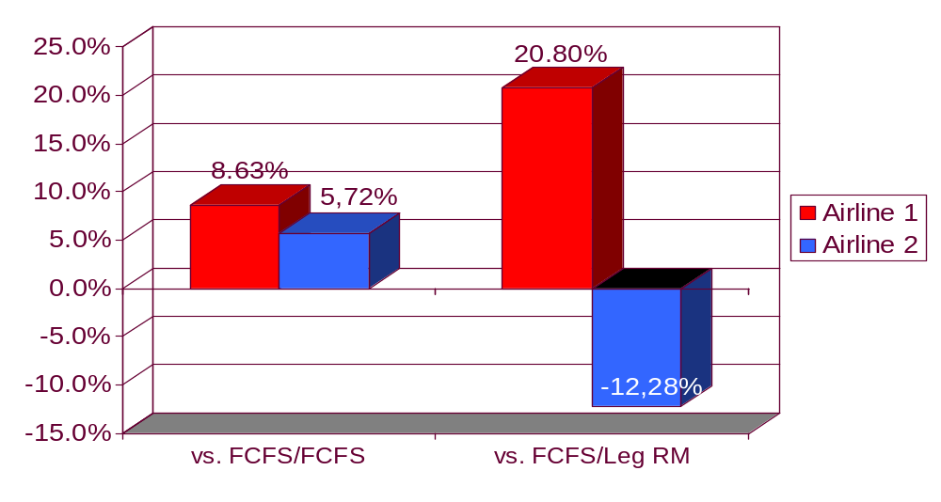
Revenue Gains with RMS
(MIT, International Center for Air Transportation – 03Mar04)
Leg RM revenue gains when Airline 1 moves from FCFS
  Over 20% gains for Airline 1, partially at expense of Airline 2’s revenues

Slide 18
Agenda
Revenue Management Role
Revenue Management Approaches
Revenue Gains with RM System
Basic Elements of RM
Passenger Behavior
Forecasting / Optimization

Slide 19
Basic Elements of RM
Inventory Control
Optimization
RM
SYSTEM
RM
Pricing
Passenger Behavior
Fares
Forecast

Slide 20
Agenda
Revenue Management Role
Revenue Management Approaches
Revenue Gains with RM System
Basic Elements of RM
Passenger Behavior
Forecasting / Optimization

Slide 21
Important Passenger Behaviors
Time of booking (early vs. late booking passengers)
Time of the year — seasonality
Time of day
Day of the week
Type of passenger— business vs. leisure
Passenger reactions to closed inventory — sell-up
Cancellation of bookings
Day of departure behavior - no show, go show, denied boarding
Group vs. individual
Ticketed vs. non-ticketed
Local vs. through passengers

Slide 22
Passenger Behavior:
Time of the Year
RM must identify seasonality periods where there are similar demand patterns to gain greater forecast accuracy
Peak
Period
Peak
Period

Slide 23
Passenger Behavior:
Holidays
Holiday travel periods are typically “peak-of-peaks” ~ greater opportunity to maximize revenue
Pool historical holiday periods to forecast future holidays
Peak
Period
Peak
Period

Slide 24
Passenger Behavior:
Early Booking vs. Late Booking
Characteristics must be carefully matched
Although both examples have the same load factor, they do not have the same behavior (early booking vs. late booking)
Load Factor
Time
Legend:
Blue Line ….. Early Booking Behavior
Red Line ….. Late Booking Behavior

Slide 25
Agenda
Revenue Management Role
Revenue Management Approaches
Revenue Gains with RM System
Basic Elements of RM
Passenger Behavior
Forecasting / Optimization

Slide 26
Forecasting Approach
Revenue Management System forecasts passenger demand using historical data and current bookings
System generates forecasts for each flight/date/segment/day-of-week/booking class

Slide 27
Optimization Process
Determines the optimal seats allocation based on the forecast result /demand, fares, and capacity for each flight/seg/date
The optimal seats allocation are developed in a four-step process:
  Planned Upgrades
  Fare Mix
  Overbooking
  Pre-departure Cancellations (Decrement)
Again, the outcome is to maximize revenue on each flight

Slide 28
Optimization:
Planned Upgrades
Objective:
Resize compartment capacities to accommodate excess demand in a lower compartment when empty seats are not anticipated to be sold in a higher compartment
Capacity
Demand
New Capacity
C
20
C demand
10
10
Due to C demand
only 10 seats
are added to Y
Excess
demand
+ 20
110
100
100
Y

Slide 29
Optimization:
Fare Mix
Assume you are controlling a flight and you have three requests for the last seat on the plane, representing:
A. a 98% chance of getting € 200
B. an 80% chance of getting € 300
C. a 50% chance of getting € 400
Which request will you accept?
200 x 0.98 = 196
300 x 0.80 = 240
400 x 0.50 = 200

Slide 30
Optimization:
Fare Mix
Objective: to maximize flight revenue by setting the optimal allocation mix among the various fares / booking classes
Virtual
Cap
Demand by
class
Optimal
Mix
C
C
J
Y
Y
M
H

Slide 31
Optimization:
Overbooking
Assume that you are controlling a single compartment flight with capacity of 100 seats and no-show percentage of 20%.
By how many seats will you overbook the flight?
Show-up % = 80%
# seats: 100 / 0.8 = 125 (25)

Slide 32
Optimization:
Overbooking
Objective:
Limit the occurrences of denied boardings and empty seats
Expected
Total Cost
Expected
Cost of Spoilage
(Opportunity Lost)
Expected
Cost of Denied
Boardings
Capacity
Cabin AU

Slide 33
Pre-departure Cancellations:
Decrement
Objective:
To anticipate pre-departure cancellations by class
Decrement
Load Factor
Time

Slide 34
QYield
5' Break

Slide 35
O&D Revenue Management:
Agenda
O&D Definition
Why O&D RM
What Is not O&D
Seamless Availability
Married segment Control
PROS O&D
O&D Benefits
Change Management
Network Cutover Plan

Slide 36
O&D Definition
O&D:
A “contiguous” journey from point of Origin and to point of Destination
Simply
Where the passenger begins and ends his or her journey

Slide 37

O&D Definition
DOH
Local O&D: O&D that involves a single leg (nonstop)
DEL
IAD
Online O&D: portion of the journey that traverses Qatar Airways network. Includes certain code-share itineraries
DOH
BKK

Slide 38


O&D Definition
Trip O&D: O&D, regardless of airlines involved; includes the interline segments of the O&D
ATL
DOH
DXB
MAD

Slide 39
O&D Definition:
Significant O&Ds and POS
Based on net booking counts, determined at country level
Both trip and online O&Ds may be deemed significant
The list of Significant O&Ds is updated periodically and can be manually edited
Significant O&Ds and POS are inputs to the Forecaster and the Fare Valuation
For every significant O&D, there should be fare available in the market
Notes:
How can

Slide 40
O&D Definition:
Moving from Leg to O&D RM
Leg RM
Segment RM
O&D RM
Emphasis on Load factor and regional volume/sales | Emphasis on Load factor and regional volume/sales | Emphasis on network contribution
Leg based input data | Segment based input data | PNR-based input data
Leg-class forecasting | Segment forecasting | Full O& D forecasting
Average Leg RBD-fare | Average Segment RBD-fare | Network-optimal bid price-balance between 3rd and 4th V/S 5th and 6th freedom
Fare valuation is limited | Fare valuation is limited | Fare valuation is an essential component of O&D RM
No POS control | No POS control | POS control

Slide 41
O&D Revenue Management:
Agenda
O&D Definition
Why O&D RM
What Is not O&D
Seamless Availability
Married segment Control
PROS O&D
O&D Benefits
Change Management
Network Cutover Plan

Slide 42
Why O&D RM ?
The traffic composition is a robust mix of connection (62%) vs. local demand (38%)
(2006 - 2007)
Point Of Sale is an extremely relevant attribute for inventory control and Revenue Management
Increase revenue by accepting passengers based on value rather than booking class

Slide 43
Why O&D RM ?
Evaluation of Booking Request in real-time
Evaluation of each Booking Request calculated individually by the system – based on the BID price
  BID Price: The Dynamic Programming simulates all possible booking events and determines the expected revenue at each point of time and for each seat available in the compartment (up to the compartment AU) by starting with the time of departure where the expected revenues are zero for any seats
Acceptance of Booking Request is revenue-driven
Optimization considers complete network, not each leg independently

Slide 44
Why O&D:
Value Driven Regardless of Booking Class
LHR
QR 002 – 1 seat available
DOH
QR 232 – 100 seats available
DEL
◆
❖
Class
Revenue
◆
LHRDOH
M
535 $
❖
LHRDEL
H
883 $
PROBLEM:
First flight full. Only highest booking class available
Revenue of itinerary is greater than itinerary
TODAY:
The minimum availability of a booking class on all legs decide on the availability
of an itinerary
In this case: itinerary is not available as H class is closed: 348 $ are lost!
❖
◆
❖

Slide 45
Why O&D:
Value Driven Regardless of Booking Class
LHR
QR 002 – 1 seat available
DOH
QR 232 – 100 seats available
DEL
◆
❖
Class
Revenue
◆
LHRDOH
M
535 $
❖
LHRDEL
H
883 $
SOLUTION
  O&D evaluates by Value independently of Booking Class
LHR DOH M 535 $ 550 
LHR DEL H 883 $ 847(550+297) ✓
Class
Revenue
Bid Price
Accepted
◆
❖

Slide 46
Why O&D:
Long-haul vs. Short-haul
KRT
Revenue 499$ - 1 seat available
DOH
Revenue 1049$– 1 seat available
PEK
◆
❖
⬥
Revenue 1410$– 1 seat available
PROBLEM:
Itinerary and compete against
Revenue of itinerary and is greater than revenue alone
TODAY:
Reservation cannot differentiate requests as long as they are in the same booking class
In case, itinerary books first, 138 $ are lost!
◆
❖
⬥
◆
❖
⬥
⬥

Slide 47
Why O&D:
Long-haul vs. Short-haul
KRT
Revenue 499$ - 1 seat available
DOH
Revenue 1049$– 1 seat available
PEK
◆
❖
⬥
Revenue 1410$– 1 seat available
SOLUTION
  O&D evaluates by Value independently of Booking Class
KRT DOH 499 $ 480 ✓
DOH PEK 1049 $ 1045 ✓
KRT PEK 1410 $ 1525(480+1045) 
Revenue
Bid Price
Accepted
◆
❖
⬥

Slide 48
Why O&D:
Point Of Sale (POS) Control
LHR
QR 002 – 1 seat available
DOH
QR 232 – 1 seat available
DEL
◆
❖
POS
Revenue
◆
LHRDEL
DEL
750 $
❖
LHRDEL
LON
883 $
PROBLEM:
Market and compete on this itinerary
Revenue of market is greater than market
TODAY:
Reservation cannot differentiate requests as long as they are in the same booking class
In this case, if market books first, 133 $ are lost!
◆
❖
❖
◆
◆

Slide 49
Why O&D:
Point Of Sale (POS) Control
LHR
QR 002 – 1 seat available
DOH
QR 232 – 1 seat available
DEL
◆
❖
POS
Revenue
◆
LHRDEL
DEL
750 $
❖
LHRDEL
LON
883 $
SOLUTION
  O&D evaluates by Value independently of Booking Class
LHR DEL DEL 750 $ 847(550+297) 
LHR DEL LON 883 $ 847(550+297) ✓
POS
Revenue
Bid Price
Accepted
◆
❖

Slide 50
O&D Revenue Management:
Agenda
O&D Definition
Why O&D RM
What Is not O&D
Seamless Availability
Married segment Control
PROS O&D
O&D Benefits
Change Management
Network Cutover Plan

Slide 51
What is Not O&D
O&D will not solve conflicts of interest
  Waitlist handling
  Group handling
  Commercial agreements
    Can be solved by improving communication!!
O&D will not solve Revenue Integrity
O&D will not solve booking misuses

Slide 52
O&D Revenue Management:
Agenda
O&D Definition
Why O&D RM
What Is not O&D
Seamless Availability
Married segment Control
PROS O&D
O&D Benefits
Change Management
Network Cutover Plan

Slide 53
Seamless Availability
Numerical instead of Alphabetical display
Online access to our Inventory
No “stored” AVS message
Traditional AVS is used as fallback
Real-time evaluation of selected availability requests based on:
  Point of sale
  Itinerary
  OAL connections
  codeshare partner

Slide 54



Availability
Booking request
GDS
Seamless Request
Availability Answer
Booking Accept - Reject
Message enters QR Reservation
and Inventory System
QR Environment
Seamless Answer
Inventory
System
Less than 1.5´´
Availability is calculated
specifically for this request
INV retrieves financial value
of request and minimum
acceptance price from
RM System components
PROS
O&D RMS
RTDP
Fare
Valuation

Slide 55
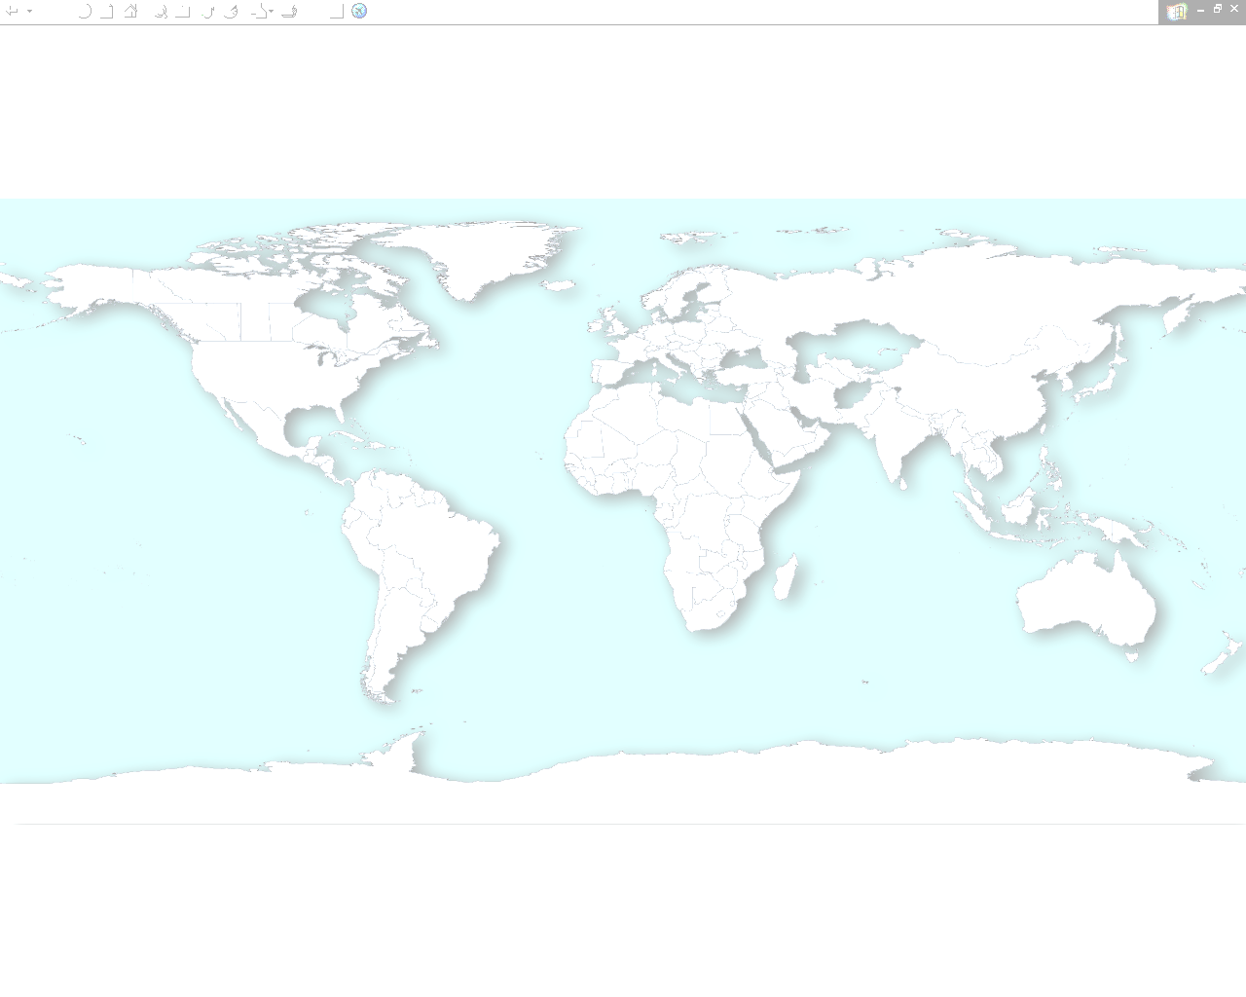
O&D RM Seamless Availability
Selective Polling (e.g. minimum LF 75%)
IAD
DOH
DEL
QR052 >75% LF: O&D Control Availability:
1. QR 052 Y9 B6 M6 H6 Q4 V4 IAD-DOH
QR232 <75% LF: NO O&D Control Availability:
1. QR 232 Y9 B9 M9 H9 Q9 V9 DOH-DEL

Slide 56
O&D RM Seamless Availability
Point Of Sale (POS) Control
IAD
DOH
Today's Availability:
1. QR 052 Y9 B6 M6 H6 Q4 V4 IAD-DOH
Availability POS US:
1. QR 052 Y9 B6 M6 H4 Q0 V0 IAD-DOH
Availability POS QA:
1. QR 052 Y9 B9 M9 H9 Q9 V9 IAD-DOH
Availability POS IN: (POS**)
1. QR 052 Y9 B2 M1 H0 Q0 V0 IAD-DOH

Slide 57
O&D RM Seamless Availability
POS Control
IAD
DOH
DEL
Today's Availability:
1. QR 052 Y9 B6 M6 H6 Q4 V4 IAD-DOH
QR 232 Y9 B9 M9 H9 Q9 V9 DOH-DEL
Availability POS US:
1. QR 052 Y9 B6 M6 H4 Q3 V3 IAD-DOH
QR 232 Y9 B6 M6 H5 Q4 V3 DOH-DEL
Availability POS IN:
1. QR 052 Y9 B6 M4 H0 Q0 V0 IAD-DOH
QR 232 Y9 B6 M4 H1 Q1 V0 DOH-DEL

Slide 58
O&D RM Seamless Availability
POS Control
DME
IAD
DOH
DEL
Availability POS US:
1. QR 052 Y9 B6 M6 H4 Q3 V3 IAD-DOH
QR 232 Y9 B6 M6 H5 Q4 V3 DOH-DEL
Availability POS US :
1. QR 052 Y9 B7 M7 H5 Q4 V4 IAD-DOH
QR 866 Y9 B7 M7 H6 Q4 V4 DOH-DME

Slide 59
Call Centre Bookings
Steps to remotely sign-in into another office id
  Sign-in into your default office id using normal sine-in transaction e.g. JI1234AB/SU
  To remotely sign-in into another office id e.g. DXBQR0121 in this case, use the following transaction:
  JUM/O-DXBQR0121/1234AB/SU
  Once prompted by the system, please enter your password
  To return to your original office id, use the following transaction: JUO
  Once prompted by the system, please enter your password

Slide 60
O&D Revenue Management:
Agenda
O&D Definition
Why O&D RM
What Is not O&D
Seamless Availability
Married segment Control
PROS O&D
O&D Benefits
Change Management
Network Cutover Plan

Slide 61
Married Segment Control
Two or more segments in a PNR are married
Married segments will be treated as one unit by the GDS
Allows better Revenue Management control due to Interactive Cancel message
  Prevents using flight connections to sell local flights that would not be available if requested outside that connection
  Capability of rejecting a cancel request in case the remaining proportion of the O&D is not available

Slide 62
Example
KRT
1 seat available
DOH
BidPrice 150 - 100 seats available
PEK
◆
❖
⬥
1 seat available
PROBLEM:
Revenue
BidPrice
Answer
Passenger wants to fly
◆
KRTDOH
375 $
480

⬥
KRTPEK
✓
Books
and closes PNR
1410 $
630 (480+150)
Re-open PNR and Cancels
❖
DOHPEK
Passenger is Happy and QR looses 1035 $

Slide 63
Example
KRT
1 seat available
DOH
BidPrice 150 - 100 seats available
PEK
◆
❖
⬥
1 seat available
SOLUTION
Married Segment Indicator set between KRTDOH and DOHPEK creates an interactive message when one tries to cancel DOHPEK.
Revenue
BidPrice
Answer
Passenger wants to fly
◆
KRTDOH
375 $
480

⬥
KRTPEK
✓
Books
and closes PNR
1410 $
630 (480+150)
Re-open PNR and Cancels
❖
DOHPEK
Partial cancellations not allowed – XX all and rebook

Slide 64
O&D Revenue Management:
Agenda
O&D Definition
Why O&D RM
What Is not O&D
Seamless Availability
Married segment Control
PROS O&D
O&D Benefits
Change Management
Network Cutover Plan

Slide 65
Overview of PROS O&D
PROS O&D will forecast demand by origin, destination, itinerary, booking class & point of sale.
Bid Prices (BP) are assigned to seats in each leg-compartment,and are the current value of that seat to the entire network.
BPs are calculated taking into account demand and fare information of the entire network.
PROS O&D uses BPs to make sell/reject decisions on requested O&Ds.
BPs are Dynamic.

Slide 66
O&D Revenue Management:
Agenda
O&D Definition
Why O&D RM
What Is not O&D
Seamless Availability
Married segment Control
PROS O&D
O&D Benefits
Change Management
Network Cutover Plan

Slide 67
O&D Benefits
O&D control generates incremental revenue of 1.66% over and above leg-based control
(Based on revenue January – December 2006)
Simulation made conservative assumptions
No user input and no real-time dynamic pricing capabilities provided by O&D control

Slide 68
O&D Revenue Management:
Agenda
O&D Definition
Why O&D RM
What Is not O&D
Seamless Availability
Married segment Control
PROS O&D
O&D Benefits
Change Management
Network Cutover Plan

Slide 69
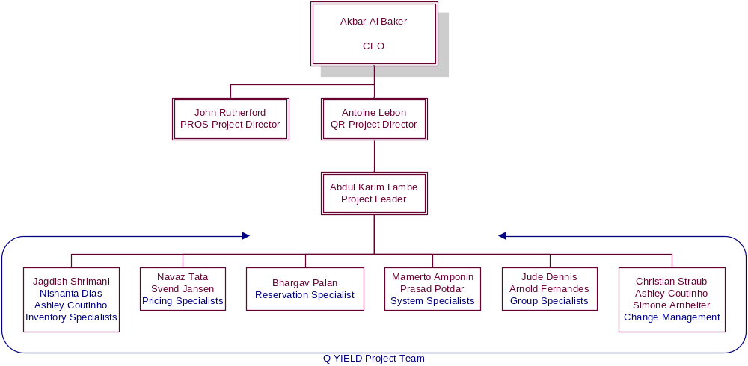
QYield Project Organization

Slide 70
Project Steering
Steering
Committee
C.E.O, GMC Ali Al Rais, Antoine Lebon, Abdul Karim Lambe, Sourav Sinha, Paul Johannes, Richard Roberts, Mahindar Singh, Ian Heywood, Dieter Westermann, John Rutherford, Pete Kiernan
Project Owner Briefing
(POB)
Antoine Lebon, Abdul Karim Lambe, GMC Ali Al Rais and Project Team
Project Team
Customer Project Board (CPB)
Abdul Karim Lambe, Christian Straub, Ashley Coutinho, Simone Arnheiter, Jagdish Shrimani, Navaz Tata, Svend Jansen, Bhargav Palan, Prasad Potdar, Mamerto Amponin, PROS
SubTeams
Part Project Leader (PPL) Meeting
Abdul Karim Lambe, Christian Straub, Ashley Coutinho, Simone Arnheiter, Jagdish Shrimani, Navaz Tata, Svend Jansen, Bhargav Palan, Prasad Potdar, Mamerto Amponin

Slide 71






Change Management Organization
Core Team
Extended Team
Christian
Straub
David Studden
Simone Arnheiter
Ground Services
Ashley Coutinho
Corporate Planning

Slide 72
Change Management Goals
Improve internal & external Communication
Restructure Revenue Management Organization
Training Coordination (internal/external, Systems, Soft Skills)
Create Awareness to internal & external Stakeholders
Sales Team members will be the project representatives in their areas

Slide 73
Move to O&D Requires a Change
With the move to O&D comes:
  New levels of responsibility & information
    Revenue
    O&Ds for a flight/leg
    Significant POS level of originating traffic
    Valuation of customers by O&D and POS
  New possibilities of alignment
    Align strategies with Network, Pricing and Sales

Slide 74
Move to O&D Requires a Change
Origin-Destination Revenue Management
  Is not only a new piece of software, it is a new way of thinking
  Depending on business processes, it may segregate passenger forecasting from flight optimization
  Creates new jobs/responsibilities/tasks
  Initiates a requirement for new information, analysis, and reporting
The organization and working relationships will change
  The number and market definition will likely change over time
Organization structure will continue to evolve with competitive, corporate, and market changes
Thus, numerous business processes must be redesigned/changed

Slide 75
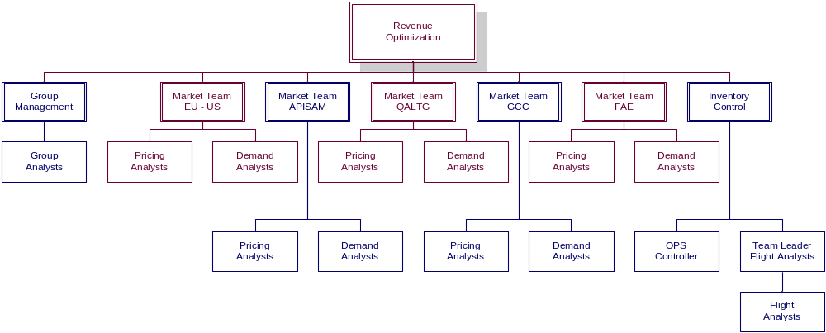
Revenue Optimization
Revenue Optimization will have 5 Market Teams
Pricing & Demand Analysts for the same market work in the same team Organized by regions based on Point-of-Sale
Flight Analysts will stay within a separate Team

Slide 76
Cross Market Teams Steering Example
LHR
Market Team
EU - US
DA – PA
POS: GB
O&D: LHR BKK
BKK LHR
BOM
Market Team
Subcontinent
DA – PA
POS: IN
O&D: BOM DXB
DXB BOM
Market Team
EU - US
DA – PA
POS: GB
O&D: NBO LHR
LHR NBO
Inventory
Control
FA 1: QR 002
- QR 076
DOH
FA 2: QR 532
FA 3: QR 612
FA 4: QR 109
- QR 111
FA 5: QR 200
Market Team
GCC
DA – PA
POS: AE
O&D: DXB BOM
BOM DXB
Market Team
Far - East
DA – PA
POS: TH
O&D: LHR BKK
BKK LHR
BKK
Market Team
Levant - Africa
DA – PA
POS: KE
O&D: NBO LHR
LHR NBO
DA – PA
POS: QA
O&D: DXB DOH
DOH DXB
DXB
NBO

Slide 77
Impact to Stations
Closer collaboration between Stations and Revenue Optimization in seeking revenue opportunities
  Demand Analysts to provide stations with more information about network traffic and sales opportunities and VV
Timely input of accurate fares into Fare Management System is critical to the success of PROS O&D

Slide 78
Change Management:
Critical Success Factors
To reap the full benefit of O&D control, we need to carry out changes in:
  Organization
  Work Processes
  Systems
Senior Management commitment and ongoing support
Continuous skills development of Staff
Network-focus Mindset

Slide 79
O&D Revenue Management:
Agenda
O&D Definition
Why O&D RM
What Is not O&D
Seamless Availability
Married segment Control
PROS O&D
O&D Benefits
Change Management
Network Cutover Plan

Slide 80


Network Cutover Plan
2 May
10 May
17 May
24 May
1 Jun
1 Oct
BAH/MHD/LXR/ALY/KIX/ICN/SGN/
KHI/LHE/PEW/ISB/ARN/TUN/IAH
40 flights – 14% of network – system range
SAH/ IKA/ AMM/ HKG/ CEB/ TRV/ NAG/
AMD/ MAN/ MUC/ KRT/ SEZ/ CCJ
38 flights – 13% of network – system range
MCT/ CAN/ DAC/ LGW/ MXP/ DAR
24 flights – 8% of network – system range
JED/ BEY/ CAI/ IST/ KUL/ BKK/ CGK/ SIN/ DPS/
KTM/ LHR/ FCO/ GVA/ EWR/ JNB/ CPT
64 flights – 22% of network – from 1 Oct
DXB/ AUH/ RUH/ ATH/ DAM/ BOM/ ZRH/ MNL/ TXL
48 flights – 17% of network – system range
PEK/ PVG/ COK/ DEL/ CMB/ MLE/ CDG/ VIE/ MAD/ IAD/ NBO/ ALG
38 flights – 13% of network – from 1 Oct
KWI/ DMM/ MNL/ HYD/ MAA/ FRA/ DME/ CMN/ TIP/ LOS
38 flights – 13% of network – system range

Slide 81


Network Cutover Plan
2 May
10 May
17 May
24 May
31 May
7 Jun
14 Jun
1 Oct
BAH/MHD/LXR/ALY/KIX/ICN/SGN/
KHI/LHE/PEW/ISB/ARN/TUN/IAH
40 flights – 14% of network – system range
SAH/ IKA/ AMM/ HKG/ CEB/ TRV/ NAG/
AMD/ MAN/ MUC/ KRT/ SEZ/ CCJ
38 flights – 13% of network – system range
MCT/ CAN/ DAC/ LGW/ MXP/ DAR
24 flights – 8% of network – system range
JED/ BEY/ CAI/ IST/ KUL/ BKK/ CGK/ SIN/ DPS/
KTM/ LHR/ FCO/ GVA/ EWR/ JNB/ CPT
64 flights – 22% of network – from 8 Jun
DXB/ AUH/ RUH/ ATH/ DAM/ BOM/ ZRH/ MNL/ TXL
48 flights – 17% of network – system range
PEK/ PVG/ COK/ DEL/ CMB/ MLE/ CDG/ VIE/ MAD/ IAD/ NBO/ ALG
38 flights – 13% of network – from 15 Jun
KWI/ DMM/ MNL/ HYD/ MAA/ FRA/ DME/ CMN/ TIP/ LOS
38 flights – 13% of network – system range

Slide 82
Questions & Answers

